Slide 1
TechFAR Hub – Sprint Zero
Current Usage & Content Landscape
U.S. Digital Service // AMANDA DAHL, Jason kattman, frank mcnally // OCTOBER 2021

Slide 2
contents
Executive Summary
Analysis Goals & Methodology
Analytics Review (Quantitative Research)
User Feedback Synthesis (Qualitative Research)
Digital Services Acquisition Landscape

Slide 3
Executive Summary
Purpose, Findings & Conclusions

Slide 4
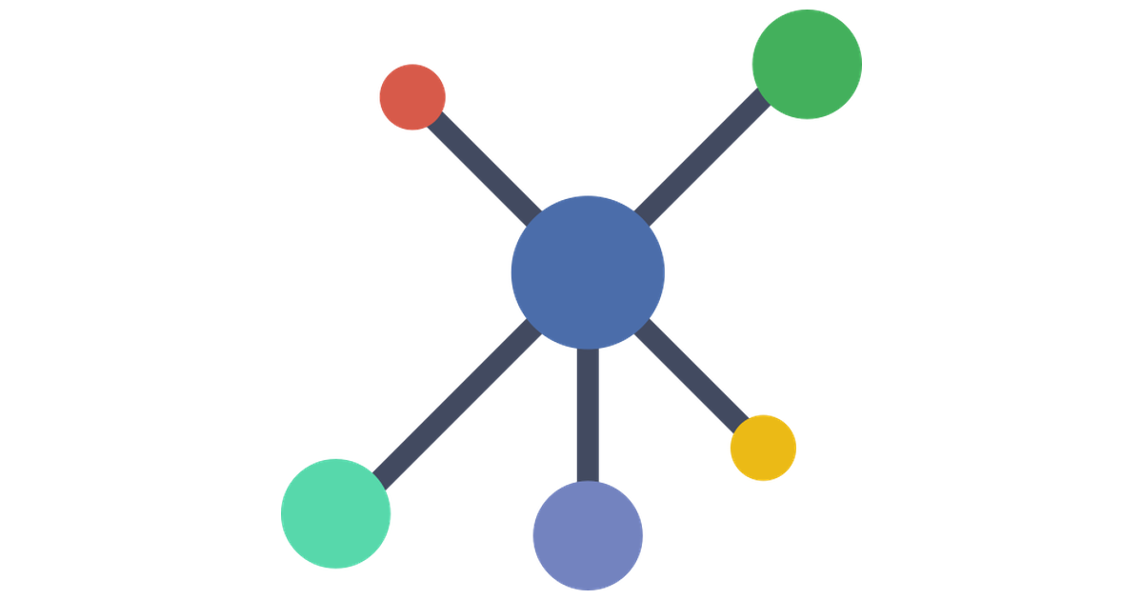
Executive summary
Background & Purpose
The third objective of USDS’ mission is to “Rethink how the Government buys digital services”.
Advancing this, USDS first published the TechFARHub within the organization's first 60 days of existence as a resource for government procurement officials seeking better ways to buy agile software development services. At the time, USDS was the primary thought leader for Digital Services procurement. Since then, the landscape has expanded, with other organizations also forming communities. TechFARHub still exists today however it has been largely untouched since the last refresh in early 2017.
In 2019, there was an effort to refresh of the TechFARHub, which made good progress in user research and content strategy analysis, but was disbanded before any updates were made to the site.
We are now at a point where USDS needs to understand the value that TechFARHub brings to the digital services acquisition community.
What other sites are out there?
Who is using techfar hub?
What do users really need?
Is techfar hub still the right thing?

Slide 5
Executive summary
Sprint 0 Objectives & Key Results (OKRs)
Objective: Increase understanding by key USDS decision-makers and #procuremenati on the positioning of TechFAR Hub in the current landscape, in order to reach a conclusion on whether to proceed to a Discovery Sprint for a site refresh.
Key Result #1: Understand who is using the TechFAR Hub
Key Result #2: Know what our users really need
Key Result #3: Identify other available resources
Key Result #4: Provide analysis on whether TechFAR Hub is still the right thing?
Key Result #5: Analyze the risks in keeping TechFAR Hub as-is vs a refresh

Slide 6





Executive summary
Innovation-minded
Key result #1 Who are our users?
Analysis and user research shows that the TechFAR Hub serves government procurement professionals with a specific interest or specialization in acquiring Digital Services (with emphasis on agile development, user centered design, product delivery, continuous integration & clean code), as well as vendors and customers.
Users run the gamut from DITAP certified professionals who are very innovation-minded, to traditionally-minded Contracting Officers, Legal and Budget who are risk averse and not interested in innovation – but may have been sent to TechFAR Hub by someone looking to convince them.
The Vendor
The Pro
The Enthusiast
Ditap novice
Ditap skilled
The Obstructionist
The Traditionalist
Traditional mindset
Notes:
Why we did this study, what we found

Slide 7







Executive summary
Key result #2
What do our users need?
Digital Services acquisition professionals have a lot of functional and emotional needs, which are detailed later in this deck. These are their high-level functional jobs.
Reduce lead time
Increase cost savings
Reduce barriers to entry
Improve customer satisfaction
Reduce protests
Achieve better mission results
Get buy-in
Notes:
Why we did this study, what we found

Slide 8
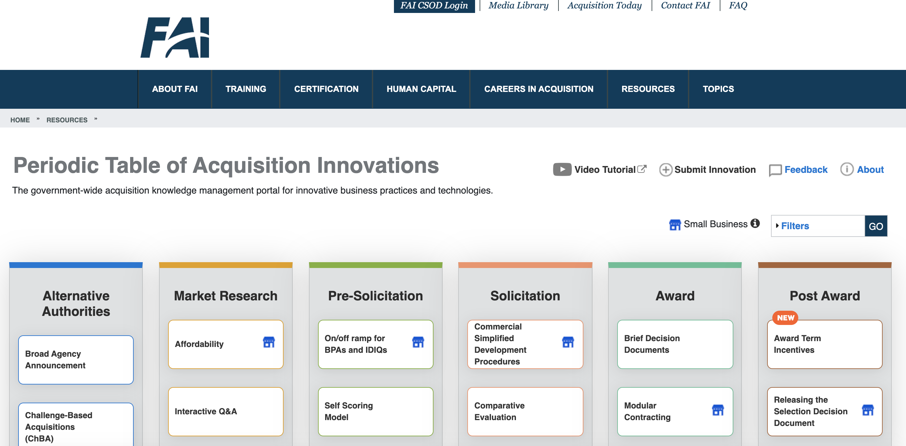
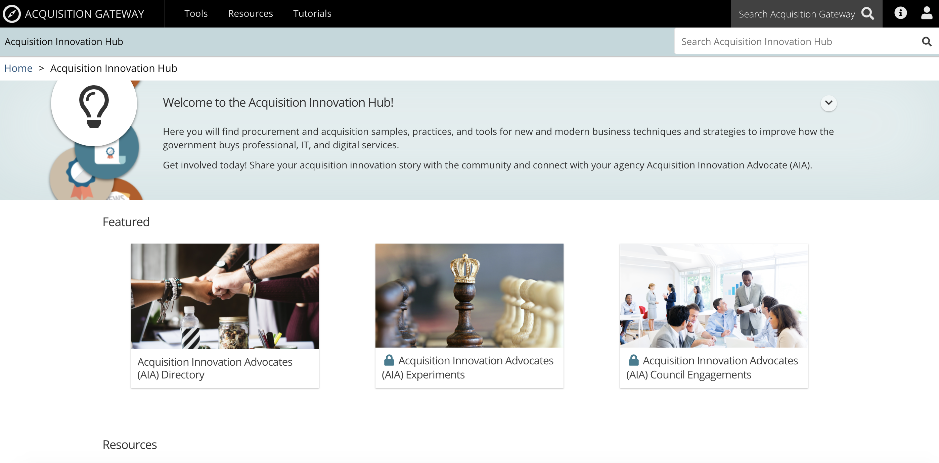
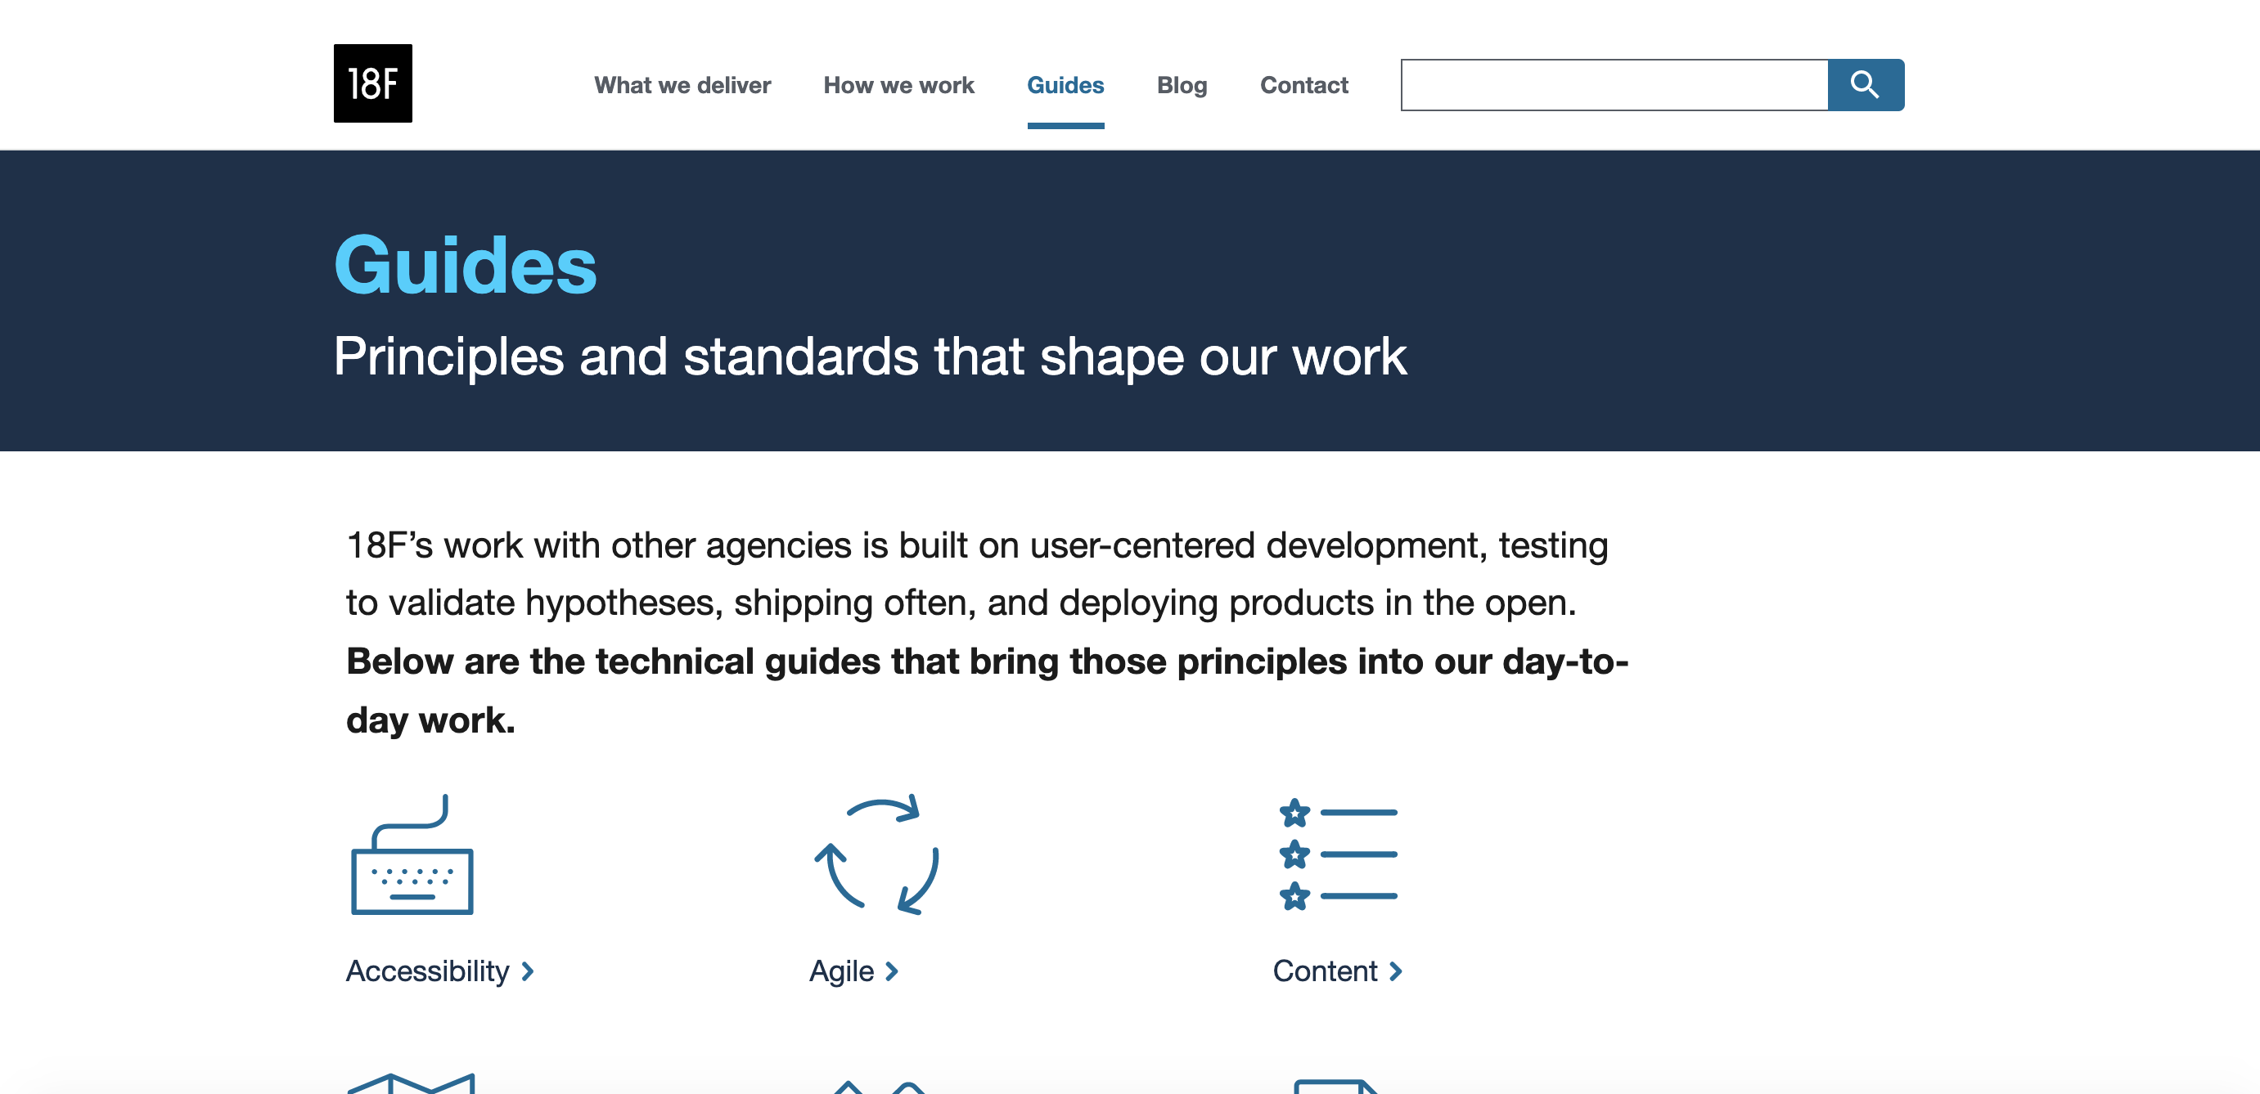
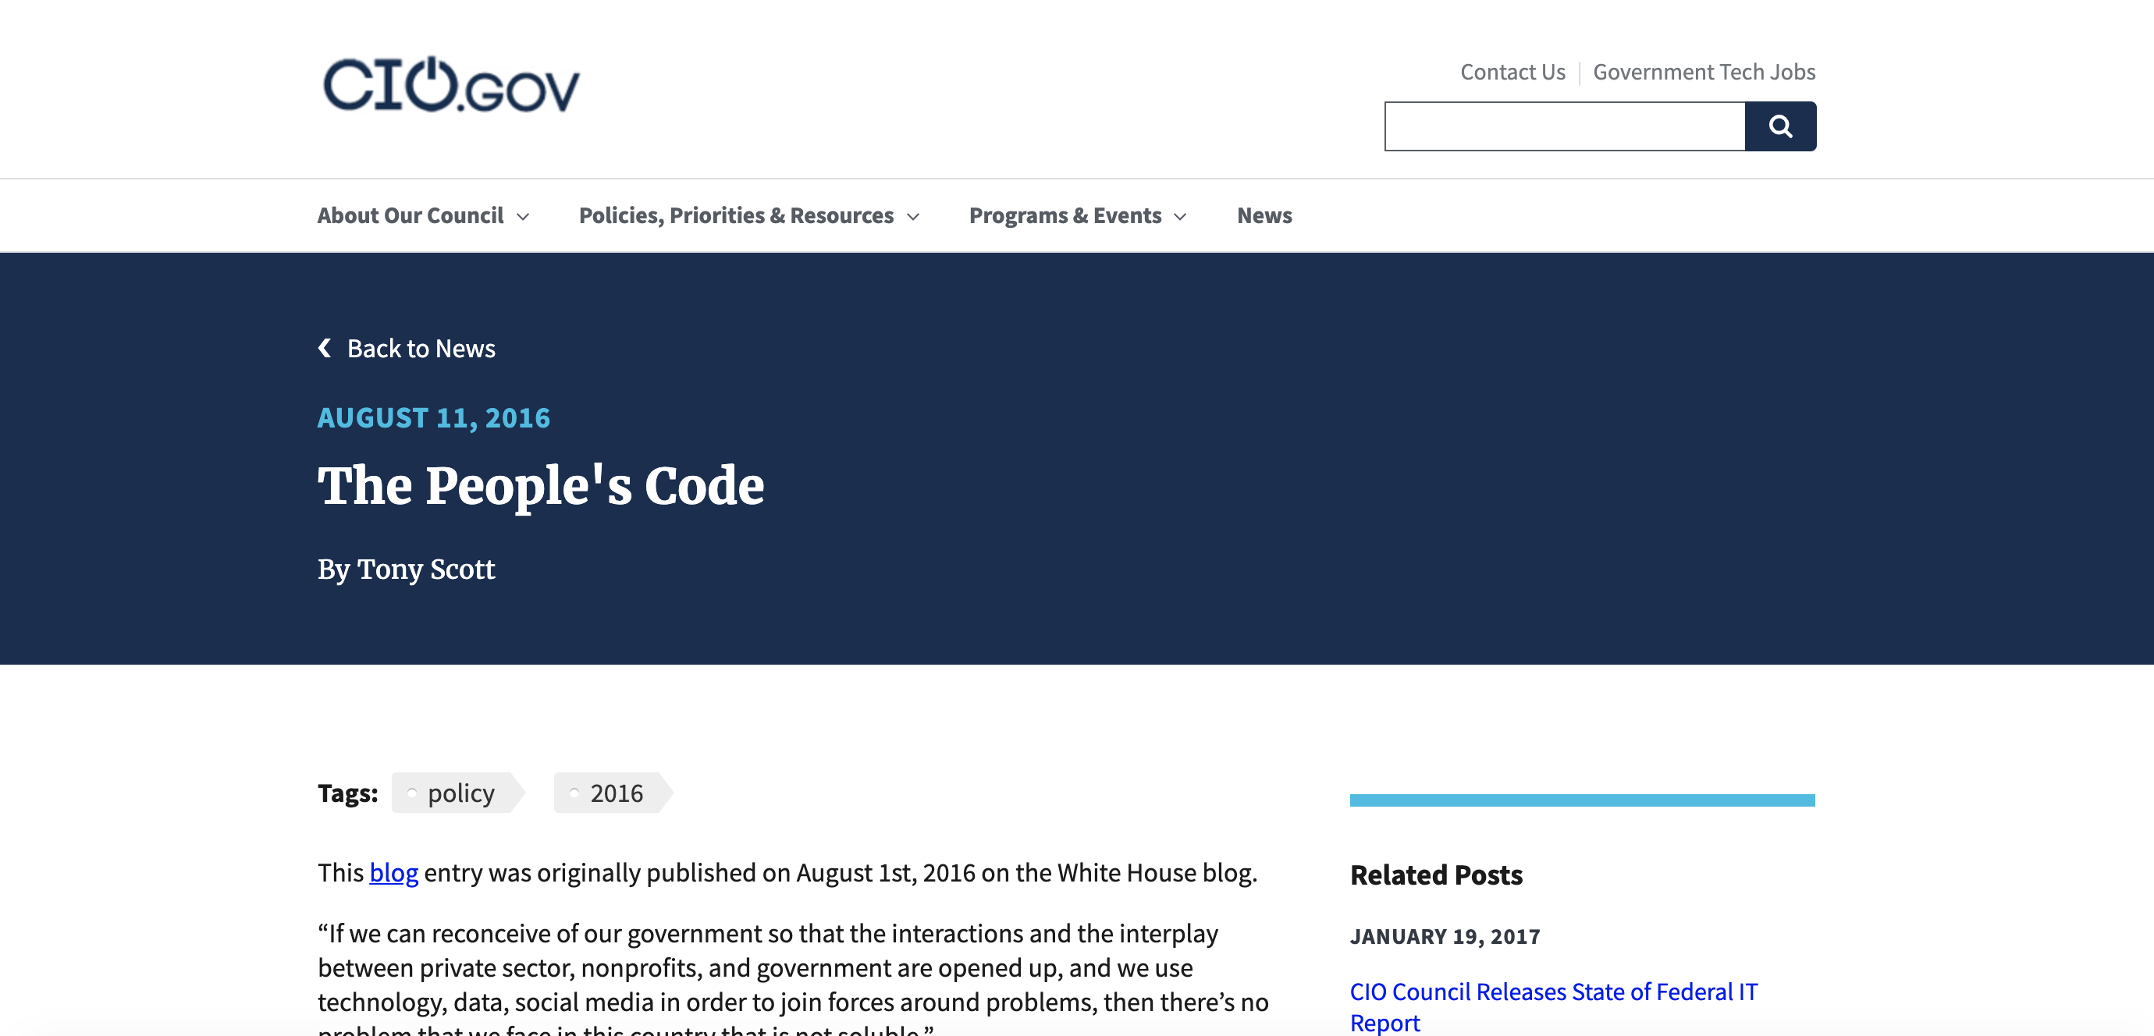
Executive summary
Key result #3
Identify other resources
A lot of innovation has bloomed across the government since TechFAR Hub’s inception in 2017, but there is still no other site that is entirely dedicated to innovation in digital services acquisition.
Procurement sites, such as the the Acquisition Gateway and the Periodic Table of Acquisition Information, cover the procurement of everything from ventilators to density meters.
Digital Services sites, like 18F, cover a bit of procurement, but focus more on advising on agile techniques in general.
Periodic Table of Acquisition Information
Acquisition Gateway
18F Guides
Federal Source Code Policy

Slide 9
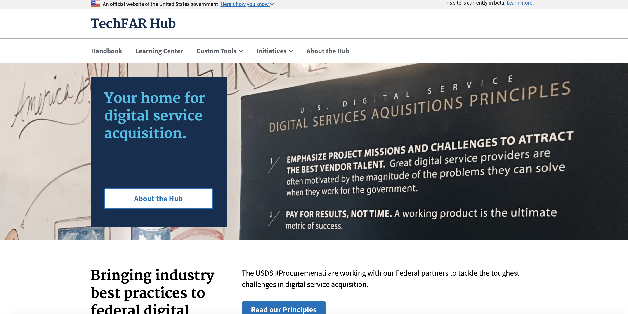

Executive summary
Key result #4 Usage Comparison
We consider Acquisition Gateway to be the closest equivalent to TechFAR Hub. When comparing the two sites, we have found that:
- TechFAR Hub gets nearly half the traffic of Acquisition Gateway, which is a positive sign, since TechFAR Hub has a smaller market
- TechFAR Hub also outperforms Acquisition Gateway on organic search & referral traffic, indicating that acquisition pros are seeking the information and other sites are pointing to the TechFAR Hub to provide value.
- Visitors stay on TechFAR Hub pages longer than they do on Acquisition Gateway, showing that they are consuming content.
However, the content on TechFAR Hub has grown stale, and analysis shows that the primary reason for procurement professionals to visit is to find out more about the Digital IT Acquisition Professional (DITAP) Certification Program. After DITAP, visitors look at the handbook and field guides and to understand more about the 8a program.
TechFAR Hub
versus
Acquisition Gateway

Slide 10
Executive summary
Key result #5 Understanding the risks
Outdated guidance
A vacuum left unfilled
Lack of support for DITAP
Loss of relevance in organic search results
Loss of USDS position of authority on digital services acquisition
Vacuum continues unfilled
Reduce the profile of DITAP
Requires USDS resources for research, development & content
Needs a plan for ongoing maintenance
Maintain Status Quo
Decommission
Refresh

Slide 11
Executive summary
Conclusions
The Audience Still Exists: The target audience of the TechFAR Hub is primarily those interested in innovating in digital services acquisition, but there is a broad range of skill levels and mindsets that need to be served.
The Audience’s Problems Still Exist: Risk reduction is still favored over innovation. Agencies still don’t have the capacity built into them for Contracting Officers to do innovative acquisition practices by default.
TechFAR Hub is still unique: The landscape for acquisition innovation in general has expanded over recent years, but no other site has emerged as the central destination for digital services.
Site usage is decent but could be better: People primarily come for DITAP information, but they also check out guides and templates. When they come, they stay for a while, but would stay longer if our content was fresh. There is an opportunity for TechFAR Hub to use it's organic position to direct information seekers to other valuable online resources like the Cloud Information Center and FAIs Periodic Table of Acquisition Innovation.

Slide 12
Analysis
Goals & Methodology

Slide 13
Sprint Zero Key Question:
Who is actually using the TechFAR hub, and what other sites around the government provide similar information?

Slide 14
Sprint zero analysis
Analytics Review & Diagnosis
User Feedback Synthesis
Identification of Other Available Resources

Slide 15
Analytics Review
Quantitative Research

Slide 16
Analytics review & diagnostics: Method
1 year time horizon (September 2020-2021)
Key Metrics: Google Analytics
Total Pageviews
Page Visits
Traffic Sources
Bounce Rate
Benchmark: Acquisition Gateway
Chosen because it represents an online resource for the entire acquisition community

Slide 17
Analytics review & diagnostics: Findings
Metric | Acquisition Gateway | TechFAR Hub | Insight
Total Pageviews Total site visits to pages within the entire domain | 105,074 | 53,749 | Despite a smaller addressable market, TFH gets nearly half the traffic
Page Visits Most popular pages visited (an indicator of a site’s utility) | [unavailable] | DITAP = 22% Handbook & Field Guides = 30% | DITAP is a primary destination for TFH; handbook and field guide type information (which is instructive/tutorial/template based) accounts for 1/3 of total traffic
Traffic Sources How the traffic was acquired (search engine, direct via url, referral from another website, etc) | Direct = 27% Organic = 32% Referral = 28% Email/Link = 13% | Direct = 23% Organic = 38% Referral = 36% Email/Link = 2% | TechFAR outperforms on organic search & referral traffic, indicating that acq pros are seeking the information and other sites are pointing to TFH to provide value
Bounce Rate The percentage of visitors who enter the site and then leave without viewing other pages; a measure of “stickiness” | 80.22% | 61.55% | TFH is “stickier” than Acq Gateway, but still room for improvement

Slide 18
User Feedback Synthesis
Qualitative Research

Slide 19
User Feedback synthesis: Method
Review of user feedback collected in a previous effort
# of users interviewed
Feedback used to create personas & Jobs to be Done

Slide 20
Personas
Representative User Types

Slide 21
DITAP certified
The Pro
“I go to TechFAR Hub for knowledge, templates and getting my mind restructured.”
The Pro is someone who is already well-versed in the special challenges of Digital Services Acquisition. They have been a Contracting Officer for a while, and understand how the wording of the FAR can be used in an Agile context. They come to TechFAR Hub to use handy tools & calculators, quickly find templates or read up on the latest protests they can learn from.

Slide 22
Not ditap certified
The Enthusiast
“I would love to see more samples of what other agencies have done on TechFAR Hub, especially things that have been protested…it would be helpful to know GAO precedence.”
The Enthusiast is curious about the potential of doing more innovative procurement for their agency. They are interested in DITAP certification and are looking to learn as much as possible from those who are more experienced.

Slide 23
NOT DITAP CERTIFIED
The Traditionalist
“if the FAR doesn’t say it, then I’m not comfortable doing it. “
The Traditionalist is a Contracting Officer, Contracting Officer Representative or Program Manager who is not comfortable going outside the historical norms of their agency context. This could be out of fear of reprisal, or pushback from Management, Legal, Budget or longer tenure Contracting Officers.

Slide 24
Not ditap certified
The Obstructionist
“There is no way that I am going to sign my name to any of this”
The Obstructionist is in Management, Legal, Budget or a long-tenure Contracting Officer who is not interested in any kind of procurement innovation. They will actively block attempts from the The Enthusiast, The Traditionalist or The Pro to do use the FAR in new and forward-thinking ways.

Slide 25
Not ditap certified
The Vendor
“Procurement is a black hole where nothing happens”
The Vendor is looking for information on how to successfully win an engagement with an agency. They want to understand the constraints that Contracting Officers are facing and how they can best tailor their bids and win business.

Slide 26
Job Stories
Identifying Functional & Emotional Goals

Slide 27
REDUCE LEAD TIME
FUNCTIONAL JOB
EMOTIONAL JOB
WHEN SITUATION
CONDUCTING A DIGITAL SERVICES ACQUISITION
WHEN SITUATION
CONDUCTING A DIGITAL SERVICES ACQUISITION
I WANT TO NEED
REDUCE LEAD TIME TO CONTRACT AWARD
I WANT TO NEED
NOT BE SEEN AS LEAVING CUSTOMERS, VENDORS OR THE PROJECT TEAM WAITING
SO I CAN GOAL
COMPLETE THE MISSION IN A TIMELY MANNER
SO I CAN GOAL
I HAVE A GOOD REPUTATION AS A CONTRACTING OFFICER

Slide 28
INCREASE COST SAVINGS
FUNCTIONAL JOB
EMOTIONAL JOB
WHEN SITUATION
CONDUCTING A DIGITAL SERVICES ACQUISITION
WHEN SITUATION
CONDUCTING A DIGITAL SERVICES ACQUISITION
I WANT TO NEED
FIND NOVEL WAYS TO APPROACH PRICING
I WANT TO NEED
KEEP COSTS TO A MINIMUM
SO I CAN GOAL
REDUCE THE OVERALL SPEND OF THE CONTRACT
SO I CAN GOAL
HAVE A REPUTATION AS AN EFFECTIVE & BUDGET-CONSCIOUS CONTRACTING OFFICER

Slide 29
REDUCE BARRIERS TO ENTRY
FUNCTIONAL JOB
EMOTIONAL JOB
WHEN SITUATION
CONDUCTING A DIGITAL SERVICES ACQUISITION
WHEN SITUATION
CONDUCTING A DIGITAL SERVICES ACQUISITION
I WANT TO NEED
FIND WAYS TO INCREASE ACCESS TO PROGRAMS LIKE 8A
I WANT TO NEED
CONSIDER WAYS TO OPEN UP ACCESS TO FEDERAL CONTRACTS
SO I CAN GOAL
MORE DIVERSE VENDORS CAN BE BROUGHT INTO FEDERAL CONTRACTS
SO I CAN GOAL
BE HELPFUL TO THE AMERICAN PUBLIC BY INCLUDING DIVERSE SUPPLIERS

Slide 30
IMPROVE CUSTOMER SATISFACTION
FUNCTIONAL JOB
EMOTIONAL JOB
WHEN SITUATION
CONDUCTING A DIGITAL SERVICES ACQUISITION
WHEN SITUATION
CONDUCTING A DIGITAL SERVICES ACQUISITION
I WANT TO NEED
FIND NEW WAYS TO STREAMLINE THE PROCESS
I WANT TO NEED
SHOW MY COLLEAGUES NEW APPROACHES
SO I CAN GOAL
IMPROVE CUSTOMER SATISFACTION
SO I CAN GOAL
GET PAST THE ”WE’VE ALWAYS DONE IT THIS WAY” CULTURE

Slide 31
REDUCE PROTESTS
FUNCTIONAL JOB
EMOTIONAL JOB
WHEN SITUATION
CONDUCTING A DIGITAL SERVICES ACQUISITION
WHEN SITUATION
CONDUCTING A DIGITAL SERVICES ACQUISITION
I WANT TO NEED
REDUCE PROTESTS
I WANT TO NEED
MY WORK TO BE BULLET-PROOF
SO I CAN GOAL
REDUCE THE CHANGE OF DELAYING THE MISSION
SO I CAN GOAL
NOT BE AFRAID OF THE CONSEQUENCES OF A PROTEST

Slide 32
ACHIEVE BETTER MISSION OUTCOMES
FUNCTIONAL JOB
EMOTIONAL JOB
WHEN SITUATION
CONDUCTING A DIGITAL SERVICES ACQUISITION
WHEN SITUATION
CONDUCTING A DIGITAL SERVICES ACQUISITION
I WANT TO NEED
UNDERSTAND A MISSION-CENTERED APPROACH TO PROCUREMENT
I WANT TO NEED
NOT GET DISTRACTED BY UNNECESSARY PROCESS
SO I CAN GOAL
NOT LOSE SITE OF THE MISSION
SO I CAN GOAL
NOT LOSE SITE OF THE MISSION

Slide 33
GET BUY-IN
FUNCTIONAL JOB
EMOTIONAL JOB
WHEN SITUATION
CONDUCTING A DIGITAL SERVICES ACQUISITION
WHEN SITUATION
CONDUCTING A DIGITAL SERVICES ACQUISITION
I WANT TO NEED
HAVE EVIDENCE OF PREVIOUS SUCCESSFUL OUTCOMES
I WANT TO NEED
NOT BE SEEN AS A LONE GUNSLINGER
SO I CAN GOAL
HAVE ALIGNMENT AND SUPPORT FROM MY TEAM & LEADERSHIP
SO I CAN GOAL
BE CONSIDERED A TEAM PLAYER & SUCCEED IN MY JOB

Slide 34
Digital Services Acquisition Landscape
Analysis of other sites

Slide 35
Identification of other available resources: method
Conduct online searches based on various keywords to identify high performing resources (ensure no unknown unknowns)
Catalog known sources (e.g., CIO Council, 18F Guides, Digital.gov, FAI Periodic Table of Acquisition Innovation)
Analyze traffic and keyword performance of these resources

Slide 36
Identification of other available resources: Findings
Resource | Link | Monthly Organic Traffic (est) | Highest Performing Keywords
TechFAR Hub | https://techfarhub.cio.gov/ | 246 | Ditap, 8a, sought, ditap program, tech far, project management epic, agile estimating tool
Cloud Information Center | https://cic.gsa.gov/ | 347 | Dod impact level, dod impact levels, disa impact levels, dod impact levels chart, cloud capability
18F Guides | https://18f.gsa.gov/guides/ | 2600 | 18f, 18f gsa, us web design standard, fec search, architecture design record, ato process
Federal Source Code Policy | https://sourcecode.cio.gov/ | 58 | Federal source code policy, opensource.gov, government open source software, government open source, code.gov
FAI Periodic Table of Acq Innovation | https://www.fai.gov/periodic-table | 2 | Periodic table gov, innovative acquisitions, far table of contents, (cost of elements in periodic table), inovations

